Slide 1
Ortho Eyes
Tony Andrioli
Business IT & Management Applied Mathematics
Kasper van der Hoofd - Rogier Zitman
Vincent van den Oord
Luke de Keizer

Slide 2
-Introduction
-Approach
-The Data
-Accomplishments
-Problems
-Next sprint

Slide 3
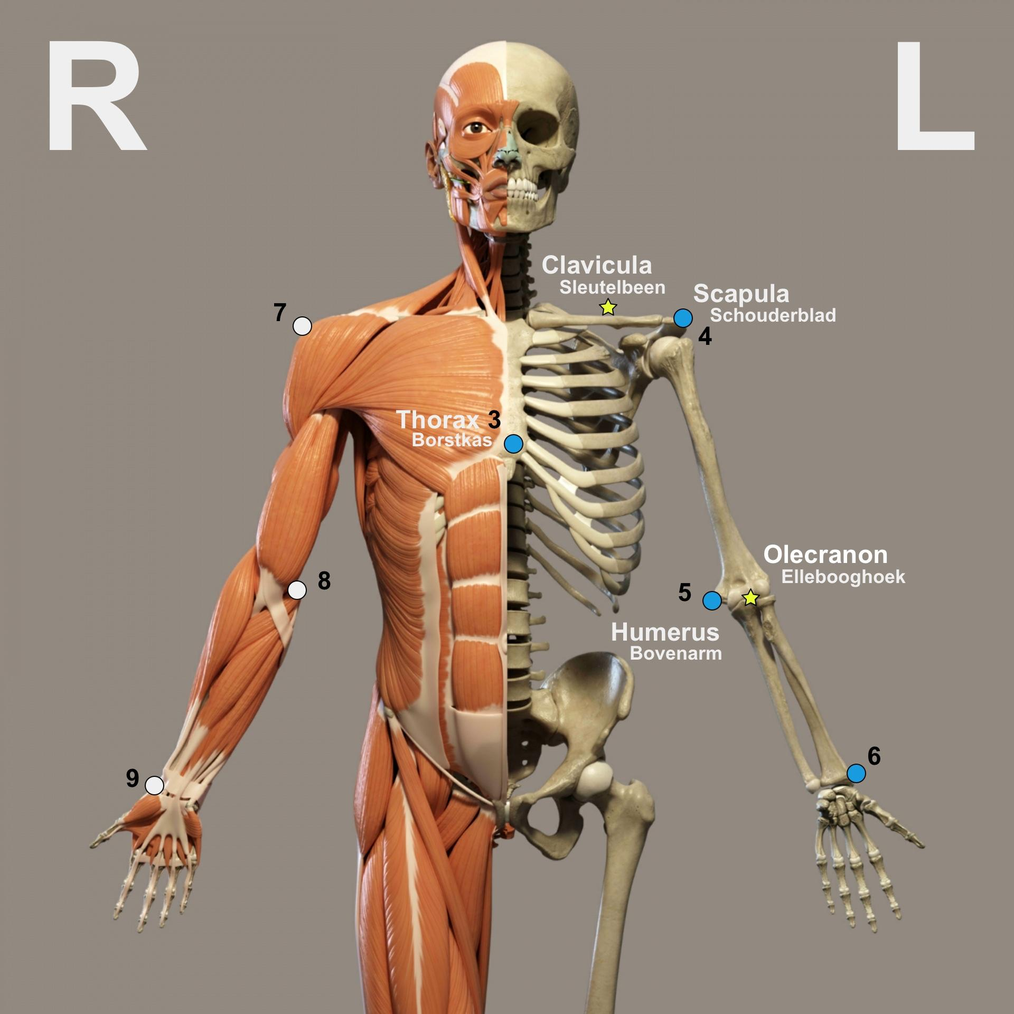
Introduction
J.H. (Jurriaan) de Groot, LUMC
Mobility of the shoulder joint
Two datasets
Sensordata (raw)
Cleaned data

Slide 4
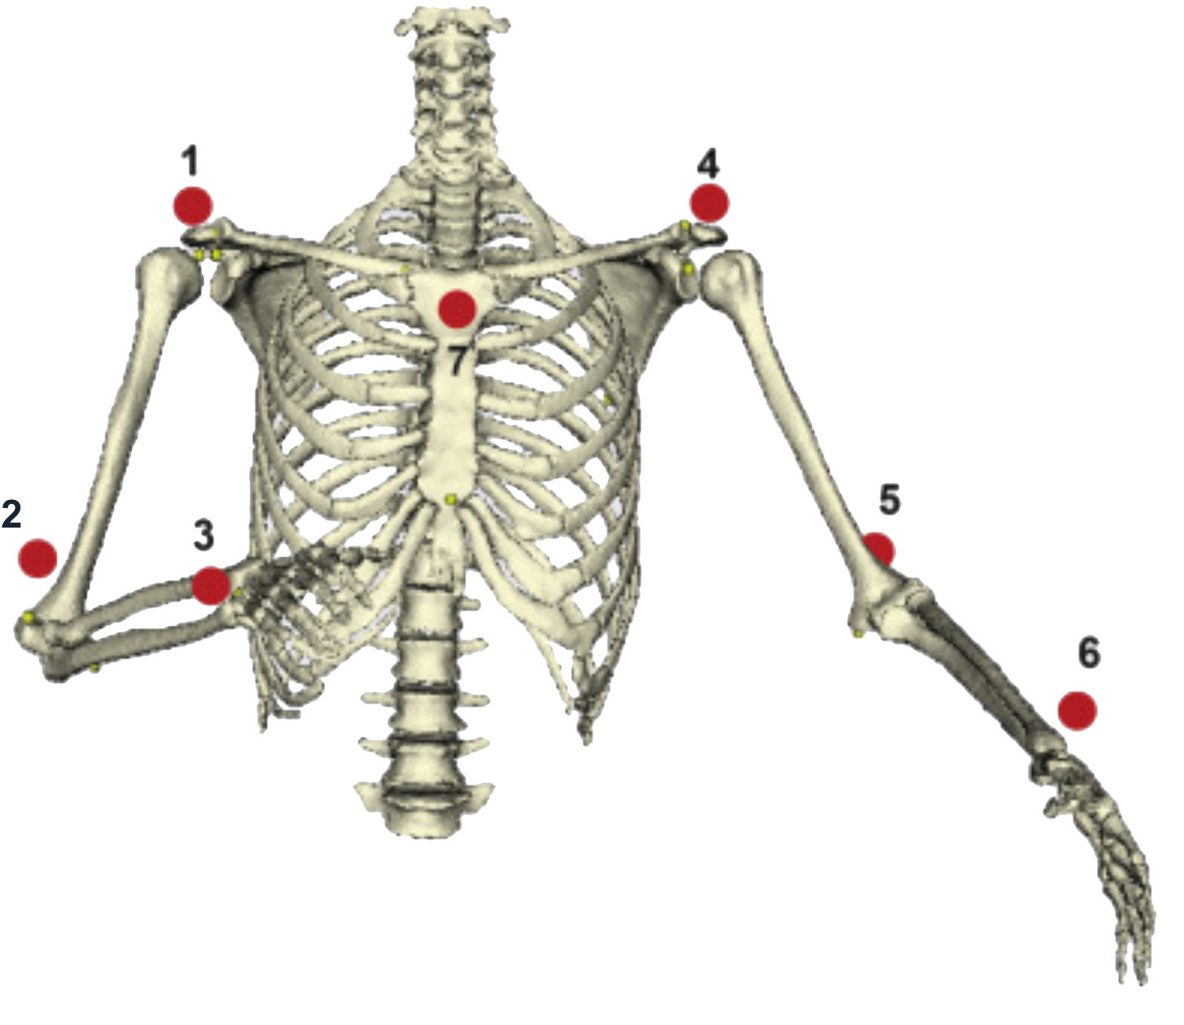
The data
The data is handed over in 2 forms:
RAW sensor data
Cleaned sensor data: Location information is lost, rotation information is translated into angles of bones.
Research on the mobility of the shoulder joint has been done on several patient groups. The available data is an anonymized version of the recorded data.

Slide 5
The questions
Research has been done on different patient groups. But it is unknown to what extend the data can be used to distinguish these patient groups. Or as put by Kolk et al., (2017): “investigate whether kinematic analyses of shoulder motion are useful for diagnostic purposes.” In data science terms: make a classifier to differentiate the patient groups.
What parameters contribute the most to this classifier.
Can the value of these parameters be measured more easily in the future?
Is the assumption that the location data is irrelevant correct?

Slide 6
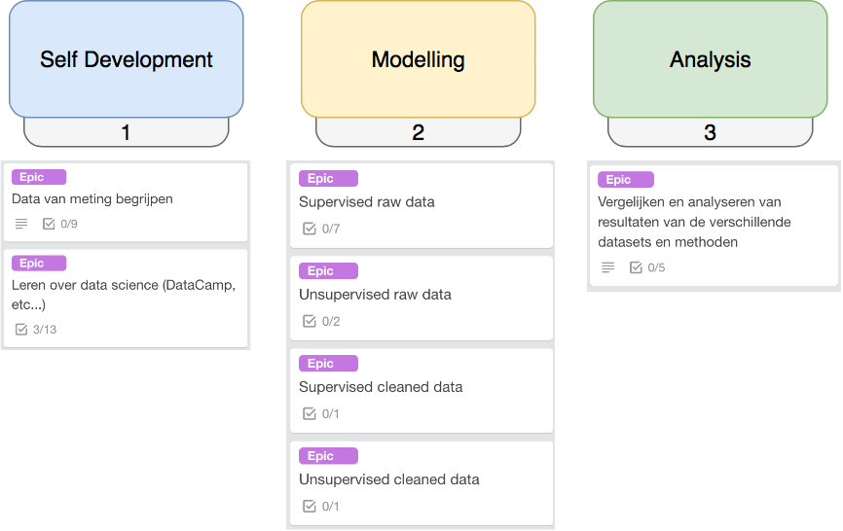
Approach
Notes:
We zijn nog steeds in de eerste fase. Data structuur is nu helder, rauwe data is afwezig.

Slide 7
[Epic] Understanding the data
Medical jargon
Anatomy of the human shoulder and arm
Cleaned data → complete dataset
Sensordata (raw)
Notes:
Eerst medische termen inzichtelijk gemaakt
Links/rechts = rechts/links
Cleaned data zijn berekende hoeken
Om de data beter te begrijpen hebben we ingezoomed op de Thorax sensor.

Slide 8
This week’s accomplishments
Practiced Python (with DataCamp)
The Coursera machine learning course
Meeting with de Groot
Cleaned data
Implementing linear regression
Standard deviation
Mean squared error
Raw data
Calculating the elbow angle
Notes:
Meeting met de groot heeft de opgeschoonde data opgeleverd

Slide 9
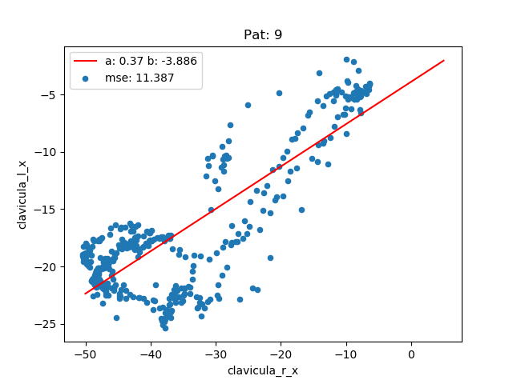
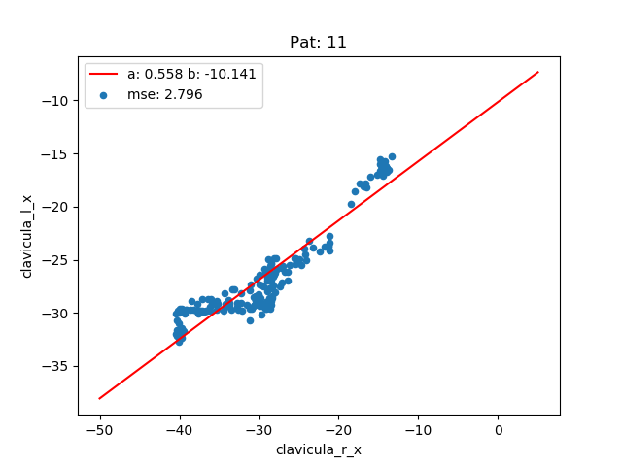
Symmetry
Per patient

Slide 10
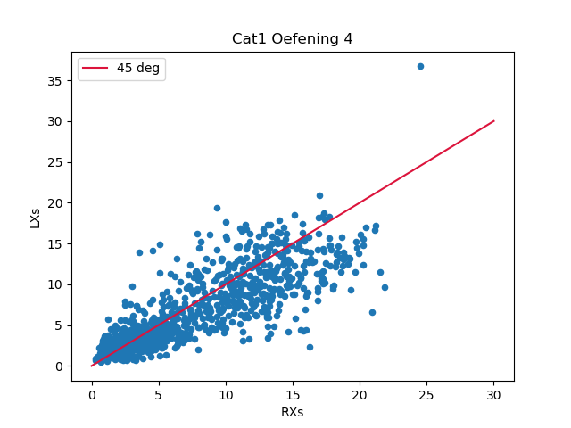
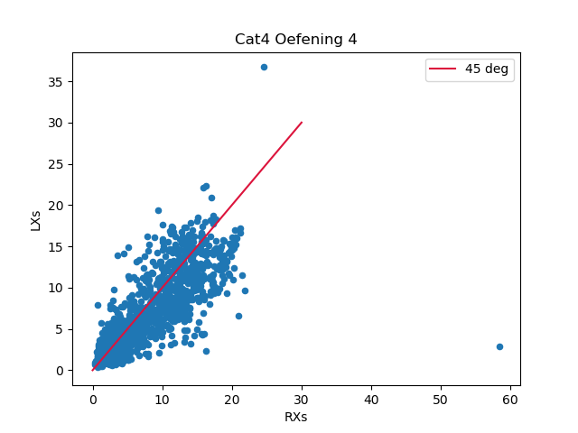
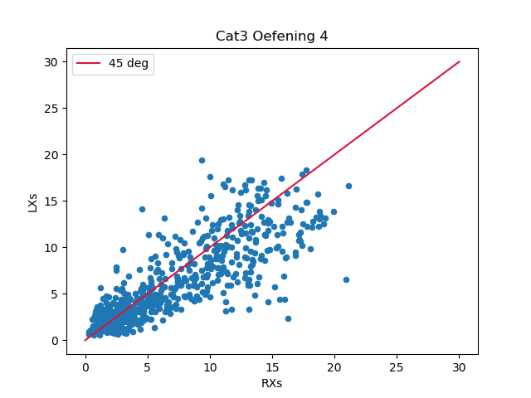
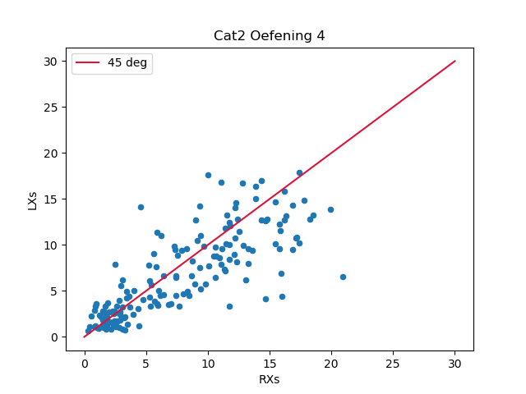

Slide 11
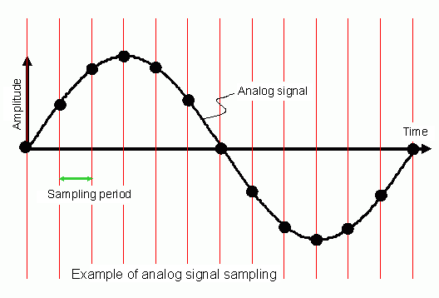
Problems
Carlijn Konings
Data
Sample frequency is not constant
Difficulty using regression techniques for the analysis of time series
Raw dataset is not available
Notes:
Sample = niet consitent
Regressie = niet gemaakt voor tijdgevoelige informatie

Slide 12
Next sprint
Visualizing more data
Linear regression techniques
Symmetry
Difference between each category
Notes:
Vergelijk hier de linker en rechter sleutelbeen. Weten nog niet watvoor een beweging x,y, of z is. Als iemand helemaal symetrisch is zou de lijn in 45 graden lopen. We denken dat het de hoogte is.

Slide 13
Any questions or suggestions?

